Slide 1
Fake News Detection In The Absence of Transformers
Raz Besaleli, Cassady Shoaff, Iyanuoluwa Shode

Slide 2
Abstract
We compare the performance of several primitive classification algorithms, including Bernoulli Naive Bayes, LinearSVC, and Logistic Regression, in automatically detecting fake news with minimal preprocessing. Although we find that Logistic Regression classification is ostensibly most effective in detecting fake news, which agrees with previous findings, there are some interesting results that might make Naive Bayes or LinearSVC that might make them appropriate candidates in domain-specific settings.

Slide 3
Dataset
created by Ruchi Bhatia, shared via Kaggle
cleaned, annotated news articles in English and German from online sources
801 real news articles
1294 fake articles
annotations include:
Whether the articles are real or fake
Publication date
Author
Source
Website URL
Type (conspiracy theory, pseudoscience, etc.)

Slide 4
Models
We compared the ability of several models to detect fake news. Among these were
Bernoulli Naive Bayes
LinearSVC
Logistic Regression
whose implementations were all provided by scikit-learn.

Slide 5

Model Selection
Bernoulli Naive Bayes
Bernoulli Naive Bayes (BernoulliNB) is a Naive Bayes classification algorithm that is designed to handle data that fits into a multivariate Bernoulli distribution. It is built off the following decision rule:
Linear SVC
Linear Support Vector Classifier (LinearSVC) is a classification algorithm that partitions data using linear support vectors obtained by supervised training.
Logistic Regression
Logistic Regression (LR) is a statistical model that fits a binary variable onto a logistic function, which may be used to determine (or, classify) the probability of a given binary state. Its use may be extended to a classification technique.

Slide 6
Procedure
After preprocessing, the data was partitioned into train and test sets (the training set was allocated 3/4 of the dataset, and the test set was allocated the remaining 1/4 of the dataset). For the sake of replicability, this was done using scikit-learn, with random_state set to 5.
Using scikit-learn implementations, each model was trained on the train set with the following parameters:
BernoulliNB
Alpha smoothing was set to 2.
LinearSVC
Default parameters were used.
Logistic Regression
C was set to 2. Maximum iterations was set to 1000. Number of jobs was set to -1 to avoid convergence failure due to training set size.

Slide 7
Evaluation
After being trained on the train set, each model was evaluated on the test set. This evaluation included a confusion matrix of true and false positives and negatives. From this, accuracy, precision, recall, F1, and support were calculated, with both raw values, and macro/weighted averages being returned.

Slide 8
Observations
After running the given models through our evaluation metric described above, it seems that logistic regression ostensibly had the best performance, with an accuracy rate of 74%. However, there were some interesting features of other models that are worth discussing.

Slide 9
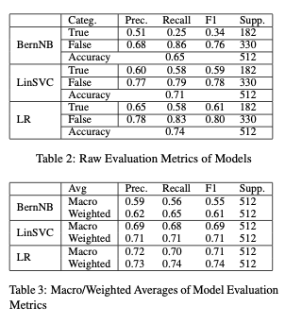
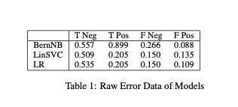
Tables

Slide 10
Bernoulli Naive Bayes
Although most other metrics were mediocre, the Bernoulli Naive Bayes classifier's ability to detect true negatives (i.e., labelling truly fake news articles as 'fake') was exceptional, with a raw True Negative rate of 0.557 (Table 1), and a False recall score of 0.86 (Table 2), which was the highest of the three models. Its raw False Negative rate was also exceptionally high, at 0.266, which may indicate that the model consistently overshoots and prioritizes catching fake news over catching authentic news, which would agree with the previously discussed metrics. Its rate of catching false positives was also exceptionally low, at 0.088. That said, its metric averages (Table 3) were consistently lower than the other two models' metric averages.

Slide 11
Bernoulli Naive Bayes: Analysis
Because the Bernoulli Naive Bayes classifier appeared to focus its attention on detecting negatives rather than detecting positives, a domain-specific use may be appropriate. For example, if there were a certain population to whom fake news could be especially detrimental due to a consistent increased presence of dog-whistles, xenophobia, or other harmful rhetoric, such an overshooting classifier could be suitable.

Slide 12
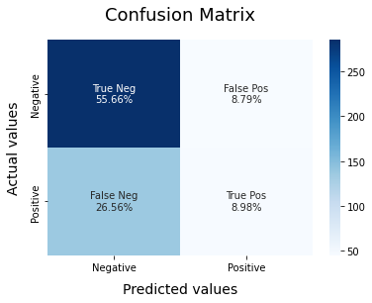
Bernoulli Naive Bayes Confusion Matrix

Slide 13
LinearSVC
The LinearSVC classifier's performance was in the middle of the BernoulliNB and Logistic Regression classifiers. It has no metrics that stands out, though if it had a lower computational load than either of the two, it would hold an advantage.

Slide 14
LinearSVC: Analysis
Because LinearSVC had no clear advantages, we are hesitant to say that it could work well in a specific domain. However, it seemed to have reasonable performance even with default parameters, which may be helpful if no specific feature is valued.

Slide 15
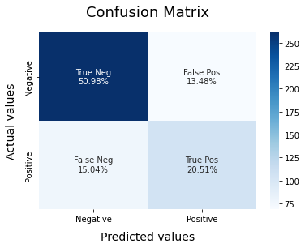
Linear SVC Confusion Matrix

Slide 16
Logistic Regression
Again, the Logistic Regression classifier's performance was considerably higher than the other models, with its metric averages being consistently the highest. Like the others, it still overshot by having a significant number of false negative errors, but has a lower number of false positives than LinearSVC, though higher than BernoulliNB.

Slide 17
Logistic Regression: Analysis
Because the raw error data of the logistic regression classifier seemed the most balanced out of the three chosen classifiers, it may be reasonable to say that it outperformed the other two. That said, similar to the LinearSVC classifier, it had no apparent, domain-specific advantages, so it is unclear how meaningful this is in this kind of interpretation. Its relatively high required training load may also be an impediment as far as computational load goes, which makes its specific comparison with LinearSVC especially unclear.

Slide 18
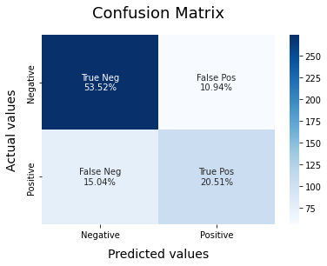
Logistic Regression Confusion Matrix

Slide 19
Conclusion
This comparison between Bernoulli Naive Bayes, Linear SVC, and Logistic Regression classifiers demonstrates that using these models for fake news detection tasks will only reach a peak of approximately 70% accuracy with minimal, yet significant preprocessing. This lack of accuracy, while not insignificant, could be greatly improved. Each method had its own benefits. Naive Bayes was best for detecting the true fakes, although it misclassified legitimate news articles. Linear SVC had low computational load, allowing researchers with limited computational resources to use this classification method. Logistic regression had the best performance of the three, but this is overshadowed by the fact that it required the most resources to run, thereby making its implementation in a lightweight pipeline feel unjustified. Further research in this direction should prioritize investigating a different approach to classification to increase accuracy, such as transformer-based models along the lines of BERT (Devlin 2018). Fake news detection to prevent the spread of misinformation is critical to the preservation of democracy.

Slide 20
References
Majed Alrubaian, Muhammad Al-Qurishi, Mabrook Al-rakhami, Sk Md Mizanur Rahman, and Atif Alamri.2015. A multistage credibility analysis model for microblogs. pages 1434–1440.
Ruchi Bhatia. 2020. How do you recognize fakenews? https://www.kaggle.com/ruchi798/how-do-you-recognize-fake-news/data.
Steven Bird, Ewan Klein, and Edward Loper. 2009. Natural language processing with Python: analyzing textwith the natural language toolkit. " O’Reilly Media, Inc.".
Jacob Devlin, Ming-Wei Chang, Kenton Lee, andKristina Toutanova. 2018. Bert: Pre-training of deep bidirectional transformers for language understand ing. arXiv preprint arXiv:1810.04805.
Aurélien Géron. 2019. Hands-on machine learning with Scikit-Learn, Keras and TensorFlow: concepts, tools, and techniquest to build intelligent systems (2nd ed.). "O’Reilly Media, Inc.".
J. D. Hunter. 2007. Matplotlib: A 2d graphics environment. Computing in Science & Engineering, 9(3):9095.
Harika Kudarvalli and Jinan Fiaidhi. 2020. Experiments on detecting fake news using machine learning algorithms. International Journal of Reliable Information and Assurance, 8:15–26.
Michael L. Waskom. 2021. seaborn: statistical dat avisualization. Journal of Open Source Software,6(60):3021.
Rowan Zellers, Ari Holtzman, Hannah Rashkin, Yonatan Bisk, Ali Farhadi, Franziska Roesner, and Yejin Choi. 2019. Defending against neural fake news. CoRR, abs/1905.12616.
Xinyi Zhou, Reza Zafarani, Kai Shu, and Huan Liu. 2019. Fake news: Fundamental theories, detection strategies and challenges. In WSDM 2019 - Proceedings of the 12th ACM International Conference on Web Search and Data Mining, WSDM 2019 - Proceedings of the 12th ACM International Conference on Web Search and Data Mining, pages 836–837. Association for Computing Machinery, Inc. 12th ACM International Conference on Web Search and Data Mining, WSDM 2019 ; Conference date: 11-02-2019 Through 15-02-2019.
Ehesas Mahir, Saima Akhter, and Mohammad Huq.2019. Detecting fake news using machine learning and deep learning algorithms. pages 1–5.
William Yang Wang. 2017. "liar, liar pants on fire": A new benchmark dataset for fake news detection. CoRR, abs/1705.00648.

